Slide 1
3D Computer Vision
Dr. Hassan Foroosh
School of EECS
UCF

Slide 2

Background
La reproduction interdite (Reproduction Prohibited), 1937, René Magritte.

Slide 3








Last Lecture …
Points and lines
Conics and dual conics

Slide 4




This Lecture …
Projective transformations

Slide 5
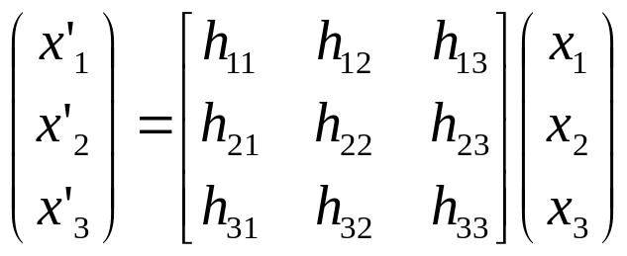

Projective transformations
Definition:
A projectivity is an invertible mapping h from P² to itself such that three points x₁,x₂,x₃ lie on the same line if and only if h(x₁),h(x₂),h(x₃) do.
Theorem:
A mapping h:P²→P² is a projectivity if and only if there exist a non-singular 3x3 matrix H such that for any point in P² represented by a vector x it is true that h(x)=Hx
Definition: Projective transformation
or
8DOF
projectivity=collineation=projective transformation=homography

Slide 6
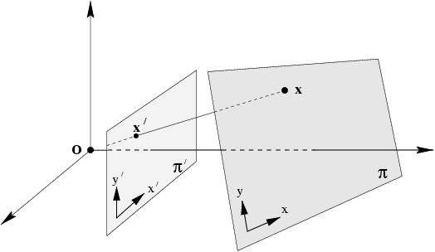
Mapping between planes
central projection may be expressed by x’=Hx
(application of theorem)

Slide 7
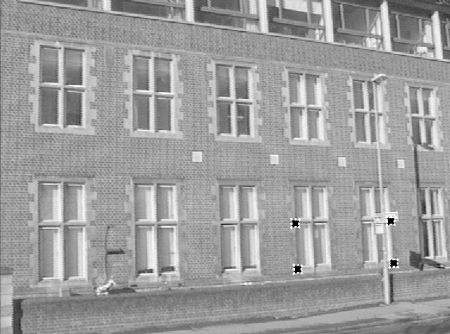
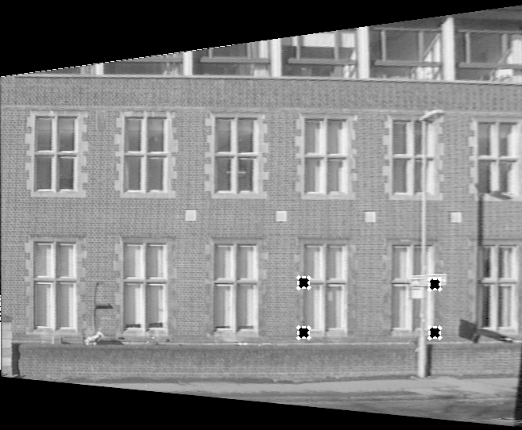
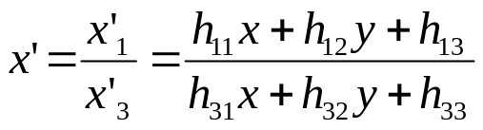
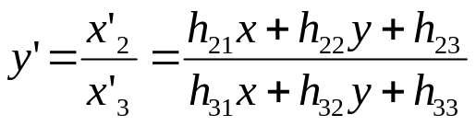

Removing projective distortion
select four points in a plane with know coordinates
(linear in h_{ij})
(2 constraints/point, 8DOF ⇒ 4 points needed)
Remark: no calibration at all necessary,
better ways to compute (see later)

Slide 8
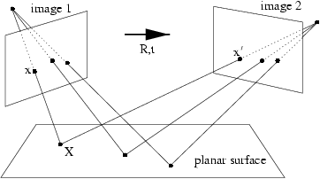
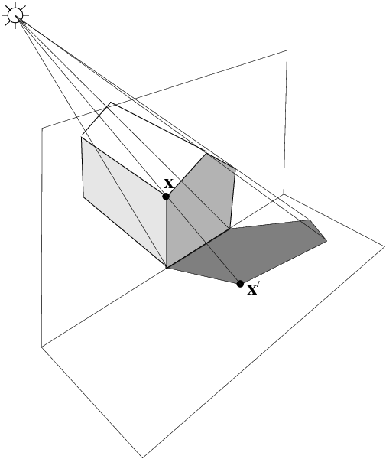
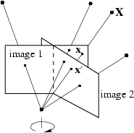
More examples

Slide 9
Homographies of Points and Lines
Computed by 3x3 matrix multiplication
  To transform a point: p’ = Hp
  To transform a line: l^{T}p=0 → l’ ^{T}p’=0
    0 = l^{T}p = l^{T}H⁻¹Hp = l^{T}H⁻¹p’ ⇒ l’ = (l^{T}H⁻¹)^{T}=H^{-T}l
    lines are transformed by premultiplication of H^{-T}

Slide 10
Transformation of lines and conics
For a point transformation
Transformation for lines
Transformation for conics
Transformation for dual conics

Slide 11
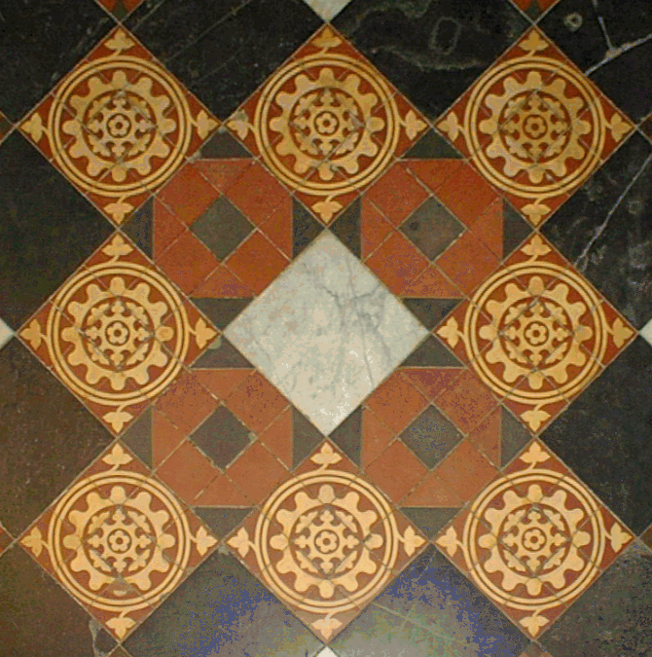
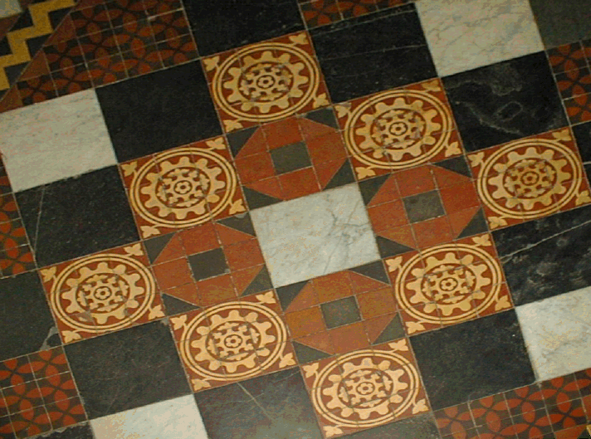
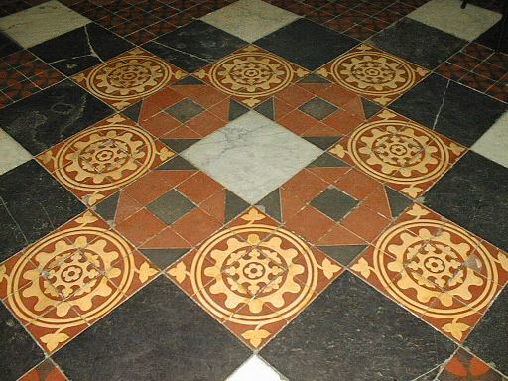
A hierarchy of transformations
Projective linear group
Affine group (last row (0,0,1))
Euclidean group (upper left 2x2 orthogonal)
Oriented Euclidean group (upper left 2x2 det 1)
Alternative, characterize transformation in terms of elements or quantities that are preserved or invariant
e.g. Euclidean transformations leave distances unchanged

Slide 12
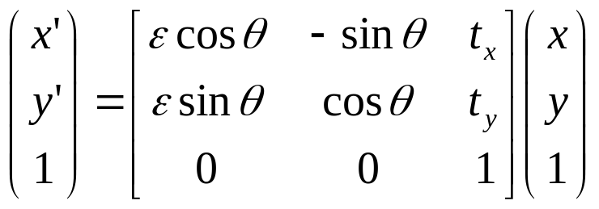



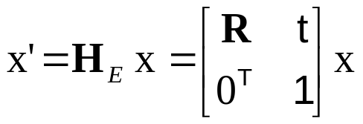

Class I: Isometries
(iso=same, metric=measure)
orientation preserving:
orientation reversing:
3DOF (1 rotation, 2 translation)
special cases: pure rotation, pure translation
Invariants: length, angle, area

Slide 13
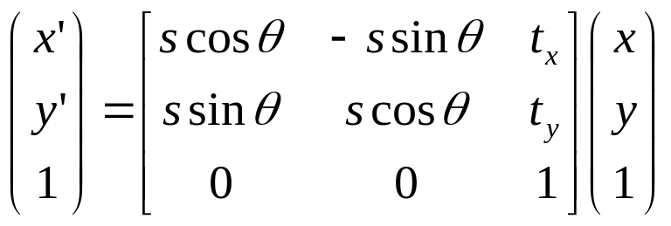
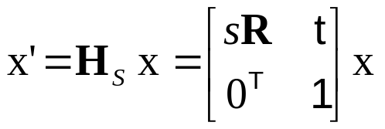
Class II: Similarities
(isometry + scale)
4DOF (1 scale, 1 rotation, 2 translation)
also know as equi-form (shape preserving)
metric structure = structure up to similarity (in literature)
Invariants: ratios of length, angle, ratios of areas, parallel lines

Slide 14
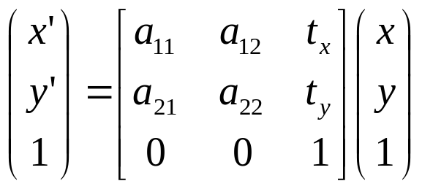
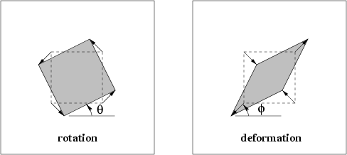
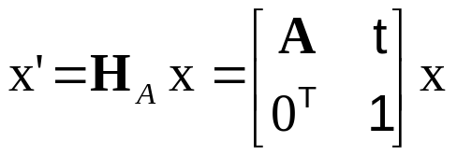
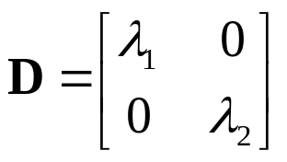

Class III: Affine transformations
6DOF (2 scale, 2 rotation, 2 translation)
non-isotropic scaling! (2DOF: scale ratio and orientation)
Invariants: parallel lines, ratios of parallel lengths,
ratios of areas

Slide 15
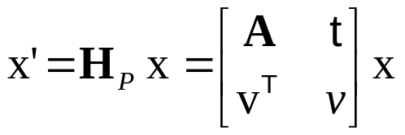

Class VI: Projective transformations
8DOF (2 scale, 2 rotation, 2 translation, 2 line at infinity)
Action non-homogeneous over the plane
Invariants: cross-ratio of four points on a line
(ratio of ratio)

Slide 16
Summary: Transformations of P²
Collineations H: P² → P² ,where det(H) not= 0
Hierarchy of transformations:
Projective: 8dof
  Invariants: concurrency, collinearity, order of contact, intersection, tangency, inflections, cross-ratio
Affine: 6dof
  Invariants: Parallelism, ratios of areas, ratio of length on a line (e.g. midpoint), linear combination of vectors (e.g. centroid), line at infinity
Similarity: 4dof: Invariants: ratio of lengths, angles
Euclidean: 3dof: Invariants: lengths, areas

Slide 17
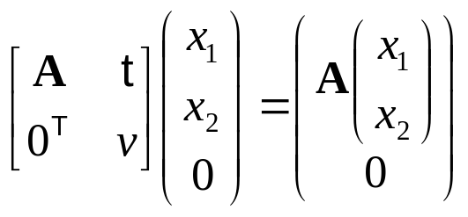
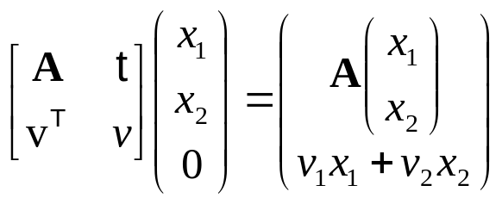
Action of affinities and projectivities on line at infinity
Line at infinity stays at infinity,
but points move along line
Line at infinity becomes finite,
allows to observe vanishing points, horizon,

Slide 18
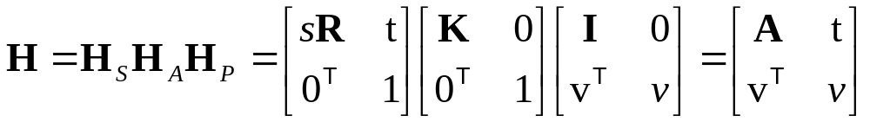



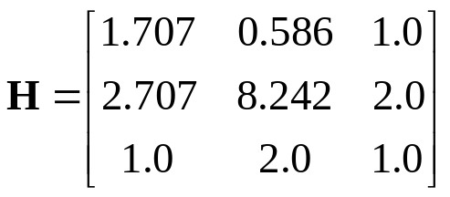
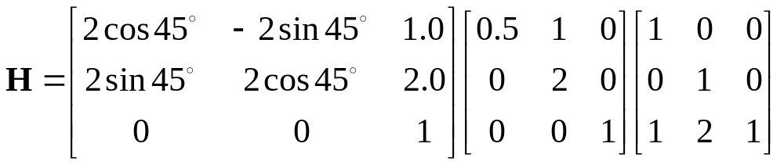
Decomposition of projective transformations
decomposition unique (if chosen s>0)
upper-triangular,
Example:

Slide 19
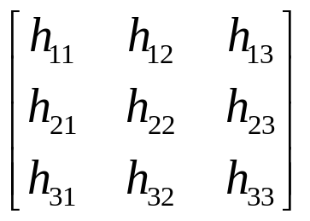
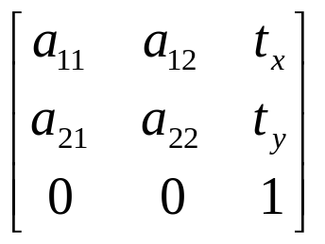
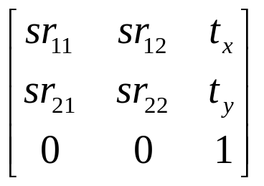
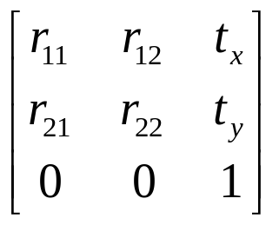
Overview transformations
Concurrency, collinearity, order of contact (intersection, tangency, inflection, etc.), cross ratio
Projective
8dof
Parallellism, ratio of areas, ratio of lengths on parallel lines (e.g midpoints), linear combinations of vectors (centroids).
The line at infinity l∞
Affine
6dof
Similarity
4dof
Ratios of lengths, angles.
The circular points I,J
Euclidean
3dof
lengths, areas.

Slide 20
Number of invariants?
The number of functional invariants is equal to, or greater than, the number of degrees of freedom of the configuration less the number of degrees of freedom of the transformation
  e.g. configuration of 4 points in general position has 8 dof (2/pt), i.e. 4 similarity, 2 affine and zero projective invariants

